Slide 1
Introduction to tilde codes

Slide 2
The tilde codes…
Tilde codes are used to create custom result pictures from mentometer system with great freedom of choice of formats and colors.
The codes are written into the result pictures, such as "~ NANS1" and replaced with a numerical value by mentometer, in this case the number of votes for option 1 (NANS1 = Number of answers # 1)

Slide 3
Hide / Unhide Tilde Codes
To show or hide the tilde codes in the presentation use the menu «tools» and choose «show/hide tilde codes»

Slide 4
How long have you been using your mentometer?
< 6 months
6-12 monts
> 1 year

Slide 5
Commonly used tilde codes 1(2)…
Description | Tilde Code | Result (will appear in presentation mode after voting)
Total number of votes for option 1 (< 6 months) | ”~NANS1” (Number of ANSwers #1) | 19
Total number of votes for option 2 (6-12 months) | ”~NANS2” (Number of ANSwers #2) | 16
Total number of votes for option 3 (> 1 year) | ”~NANS3” (Number of ANSwers #3) | 15
Total number of responses | ”~TANS” (Total number of ANSwers) | 50
Percentage of votes for option 1(< 6 months) | ”~PANS1” (Percent ANSwers #1) | 38%
Percentage of votes for option 2 (6-12 months) | ”~PANS2” (Percent ANSwers #2) | 32%
Percentage of votes for option 3 (> 1 year) | ”~PANS3” (Percent ANSwers #3) | 30%

Slide 6
Commonly used tilde codes 2(2)…
Description | Tilde Code | Result (will appear in presentation mode after voting)
Wording of the question | ”~QUES” (QUEStion) | How long have you been using your mentometer?
Answer option 1 | ”~ANSW1” (ANSWers #1) | < 6 months
Answer option 2 | ”~ANSW2” (ANSWers #2) | 6-12 monts
Answer option 3 | ”~ANSW3” (ANSWers #3) | > 1 year
Average of the answers | ”~AVER” (AVERage) | 2
Average of the answers with one decimal | ”~AVER.1” (AVERage) | 1,9
Average of the answers with 2 decimals | ”~AVER.2” (AVERage) | 1,92

Slide 7
Diagram
Code "~ RSIZx" adapts a textbox size by the percentage of votes for option x proportionally to its original full size, representing the text-box size to 100%. Animations can be used for a more effective presentation of the chart.
100%
90%
80%
70%
60%
50%
40%
30%
20%
10%
38%
32%
30%
0%
< 6 months
6-12 monts
> 1 year

Slide 8
Diagram
Code "~ RSIZx" adapts a textbox size by the percentage of votes for option x proportionally to its original full size, representing the text-box size to 100%. Animations can be used for a more effective presentation of the chart.
< 6 months
38%
6-12 monts
32%
> 1 year
30%

Slide 9
Which group do you belong to?
Alpha
Brava
Charlie
Delta

Slide 10
Tilde codes for grouping…
Description | Tilde Code | Result (will appear in presentation mode after voting)
Total votes on option 1 (on slide 270) for those in group 3 (from slide 272) | ”~NANS1(270)GROUP3(272)” (Number of ANSwers #1) | 5
Total votes on option 2 (on slide 270) for those in group 3 (from slide 272) | ”~NANS2(270)GROUP3(272)” (Number of ANSwers #2) | 5
Total votes on option 3 (on slide 270) for those in group 3 (from slide 272) | ”~NANS2(270)GROUP3(272)” (Number of ANSwers #3) | 3
Number of people in group 3 | ”~NANS3(272)” (Number of ANSwers #3) | 13
Rate of votes for option 1 (on slide 270) for those in group 3 (from slide 272) to one decimal place | ”~PANS1.1(270)GROUP3(272)” (Percent ANSwers #1) | 38,5%
Rate of votes for option 2 (on slide 270) for those in group 3 (from slide 272) to one decimal place | ”~PANS2.1(270)GROUP3(272)” (Percent ANSwers #2) | 38,5%
Rate of votes for option 3 (on slide 270) for those in group 3 (from slide 272) to one decimal place | ”~PANS2.1(270)GROUP3(272)” (Percent ANSwers #3) | 23,1%

Slide 11
In which year the ABBA won the Eurovision contest?
1964
1974
1984
1994

Slide 12
Common tilde codes in quiz…
Description | Tilde Code | Result (will appear in presentation mode after voting)
Number of correct answers | ”~NCOR” (Number of CORrect answers) | 17
Procentage of correct answers with a decimal | ”~PCOR” (Percent CORrect answers) | 34,0%
ID of the winner (position 1) | ”~WKID1” (Winner Keypad ID in place #1) | 20
Name of the winner (position 1) | ”~WNAM1” (Winner NAMe in place #1) | Anonymous
Score of the winner (position 1) | ”~WSCO1” (Winner SCOre in place #1) | 1
Total time of the winner (position 1) with 2 decimals | ”~WTIM1.2” (Winner TIMe in place #1) | 1,53
ID of the second best (position 2) | ”~WKID2” (Winner Keypad ID in place #2) | 15

Slide 13
Tilde Codes for group quiz…
Description | Tilde Code | Result (will appear in presentation mode after voting)
Name of the winner group (position 1) | ”~GWNA1” (Group Winner Name in place #1) | Alpha
Score of the winner group with a decimal (position 1) | ”~GWSC1.1” (Group Winner SCore in place #1) | 0,44
Time of the group winner (position 1) | ”~GWTI1.2” (Group Winner TIme in place #1) | 8,09
Name of the second best group (position 2) | ”~GWNA2” (Group Winner Name in place #1) | Charlie
Score of the second best group with a decimal (position 2) | ”~GWSC2.1” (Group Winner SCore in place #1) | 0,38
Time of the second best group (position 2) | ”~GWTI2.2” (Group Winner TIme in place #1) | 10,73

Slide 14
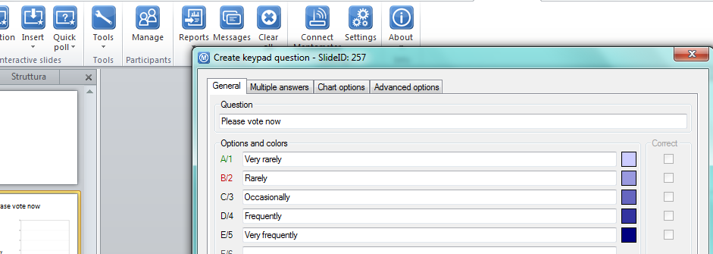
Recalling values from questions around the presentation 1(2)…
The «slide ID» can be found in the question editing window

Slide 15
Recalling values from questions around the presentation 2(2)
Beskrivning | Tildekod | Resultat (visas bara i presentationsläge)
Total votes on option 1 in latest question | ”~NANS1” (Number of ANSwers #1) | 12
Total votes on option 1 in the second latest question | ”~NANS1(-1)” (Number of ANSwers #2) | 9
Total votes on option 1 in the third latest question | ”~NANS1(-2)” (Number of ANSwers #3) | 19
Total votes on option 1 in question with ID 272 | ”~NANS1(272)” (Number of ANSwers #1) | 9
Total votes on option 1 in question with ID 271 | ”~NANS1(271)” (Number of ANSwers #2) | 12
Total votes on option 1 in question with ID 270 | ”~NANS1(270)” (Number of ANSwers #3) | 19

Slide 16
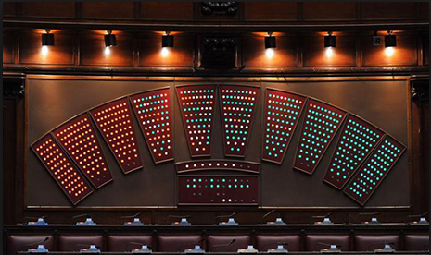
Creating the «government» effect with ~ICOL
~ICOL allows to change the color of a PowerPoint shape based on the button pressed on the keypad.
To make this slide work with your system you need to edit the value of ICOL to match the IDs of the keypad you are using.

Slide 17
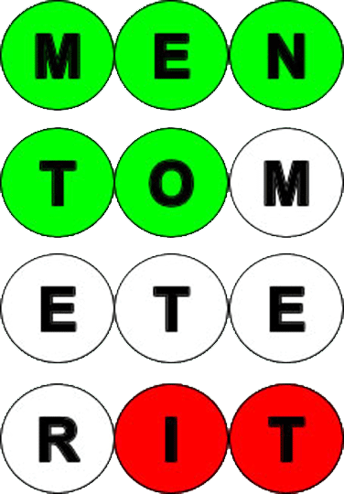
Creating the government effect with ICOL 2(2)
Yes
No
No Vote

Slide 18
Connect your device..
http://www.viareply.com/keypad.aspx?SessionID=VVALLEY&PIN=1234

Slide 19
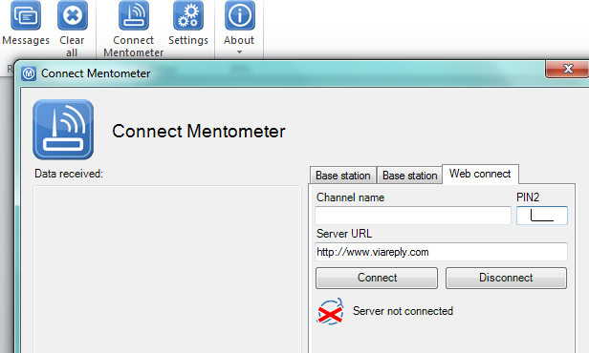
On the PC insert Channel name and PIN code and press «connect»...

Slide 20
Try voting now from your smartphone
Press 1
Press 2
Press 3
Press 4

Slide 21
Any question please get in touch with us!
office@mentometer.it
393 039 5284

